Slide 1
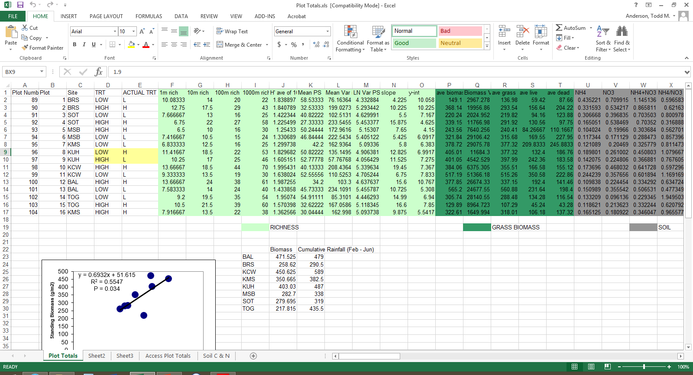
Effective data analysis…
…begins with effective data management
These days are over!

Slide 2
Some Simple Guidelines for Effective Data Management
1. Use a scripted program for analysis – R
2. Store data in nonproprietary software formats (e.g., comma delimited text file, .csv)
3. Store data in nonproprietary hardware formats (the internet)
4. Always store an uncorrected data file with all its bumps and warts. Do not make any corrections to this file; make corrections within a scripted language

Slide 3
Some Simple Guidelines for Effective Data Management
5. Use descriptive names for your data files
6. Include a “header” line that describes the variables as the first line in the table
7. Use plain ASCII text for your file names, variable names, and data values
8. When you add data to a database, organize so that rows are sampling units and columns represent information about the sampling unit

Slide 4
Some Simple Guidelines for Effective Data Management
9. All cells within each column should contain only one type of information (i.e., either text, numerical, etc.)
10. Record a single piece of data (unique measurement) only once; separate information collected at different scales into different tables. In other words, create a relational database
11. Record full information about taxonomic names
12. Record full dates, using standardized formats (YYYY-MM-DD), and complete location data (lat-long is best)
13. Always maintain effective metadata (meaning of column headers, units of entries, meanings of samples in rows). Any information needed to understand the entries of a data file should be clearly articulated in an associated file.

Slide 5
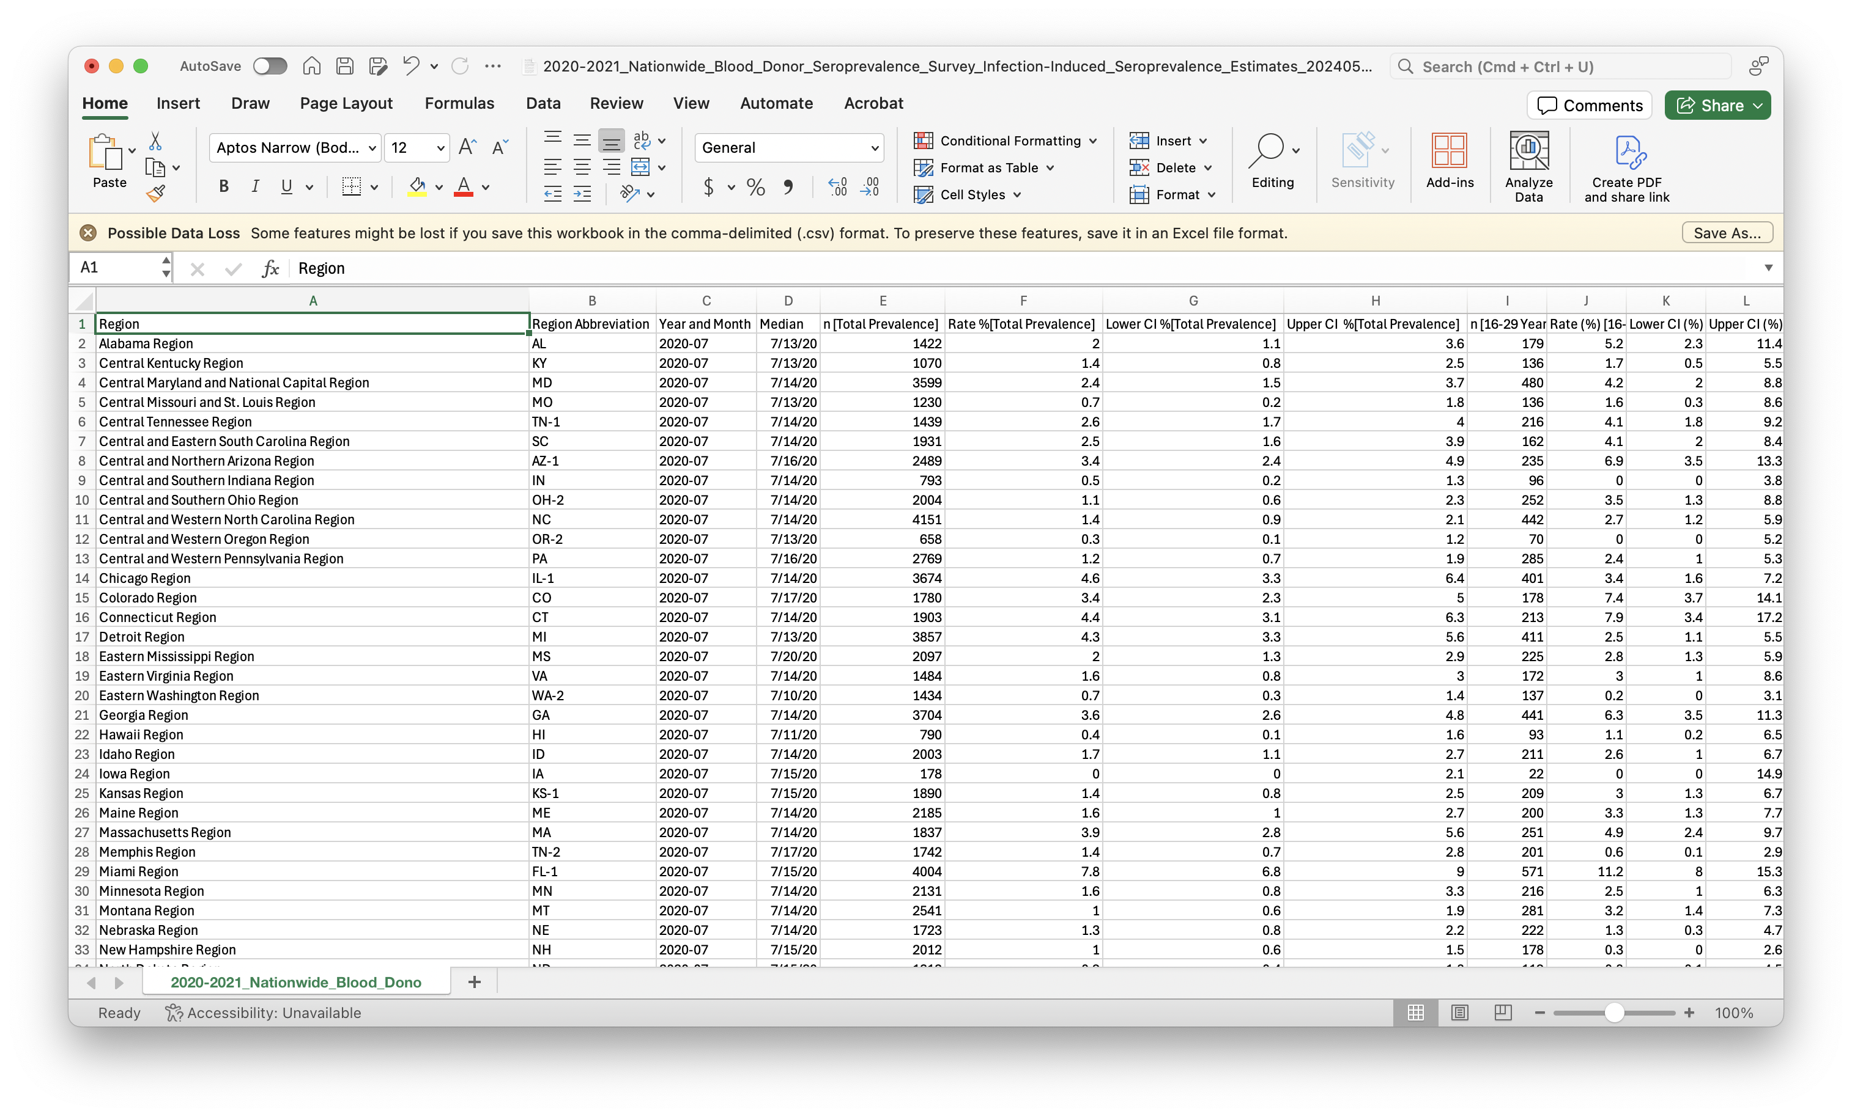

Slide 6
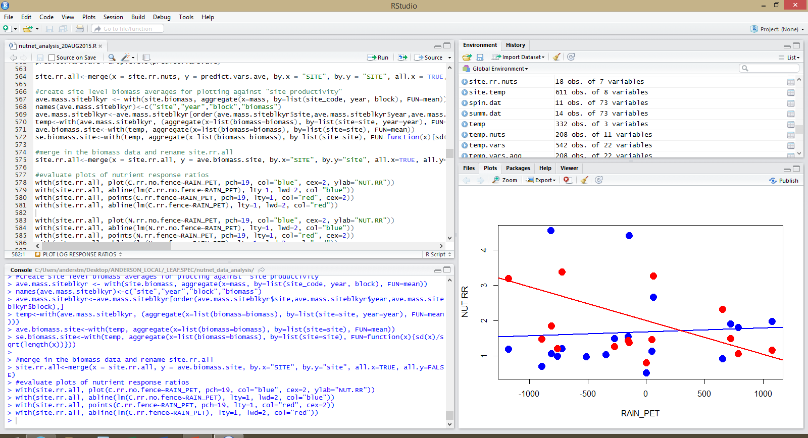
R: A First Look
Environment
(list of objects)
Script
(text editor)
Outputs
(file, plots, packages)
Console
(code gets executed)

Slide 7
Identify scientific questions
Choose deterministic model(s)
Choose stochastic model(s)
Fit parameters
Estimate confidence intervals/select models
Put results together to answer question
ask scientific questions
collect data
stochastic model(s)
deterministic model(s)
estimate parameters
estimate confidence regions
answer questions
Notes:
Identify scientific questions
- know your question
- balance generality/specificity (while not being vague: explore climate change effects on plants)
Choose deterministic model(s)
- phenomenological/mechanistic expectation in the absence of noise
Choose stochastic model(s)
- what is the variation around the expected pattern?
- measurement error (rnorm) + natural probability processes (many other p.dist)
Fit parameters
- estimate the deterministic and stochastic parameters (no real biology involved in this step)
Estimate confidence intervals/select models
- obtain reasonable estimates of uncertainty
- test hypotheses
- select among candidate models
Put results together to answer question
- return to step #1 and continue

Slide 8
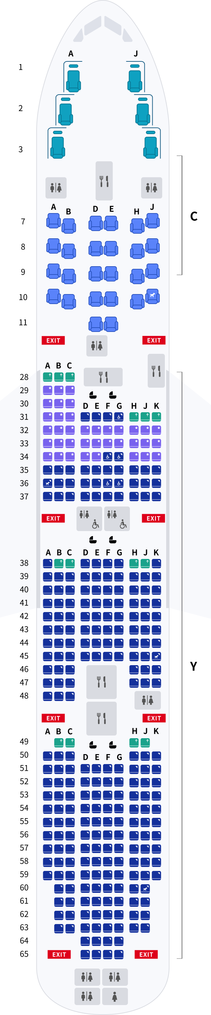


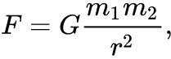
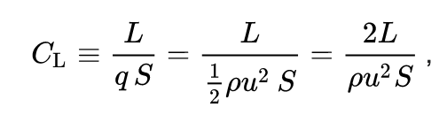
Models
Models are simplifications of the world that include information needed to understand a specific aspect of a system without other detail.
Model to understand passenger occupancy and arrangement
Model to illustrate appearance
Model to illustrate flying behavior
Model to understand forces affecting flight

Slide 9
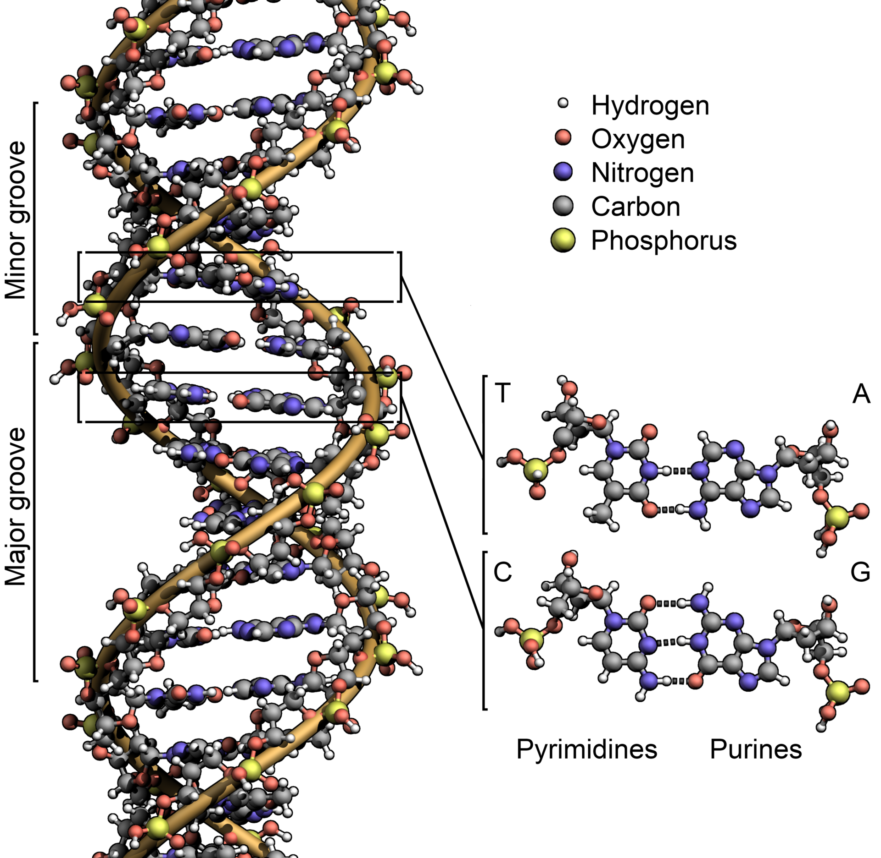
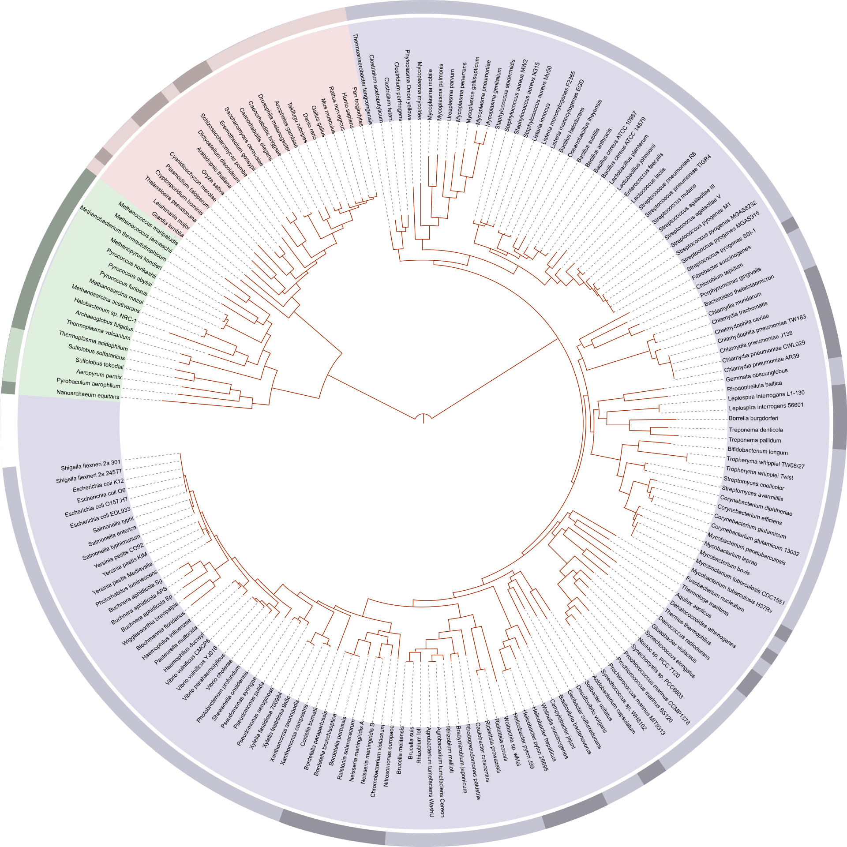
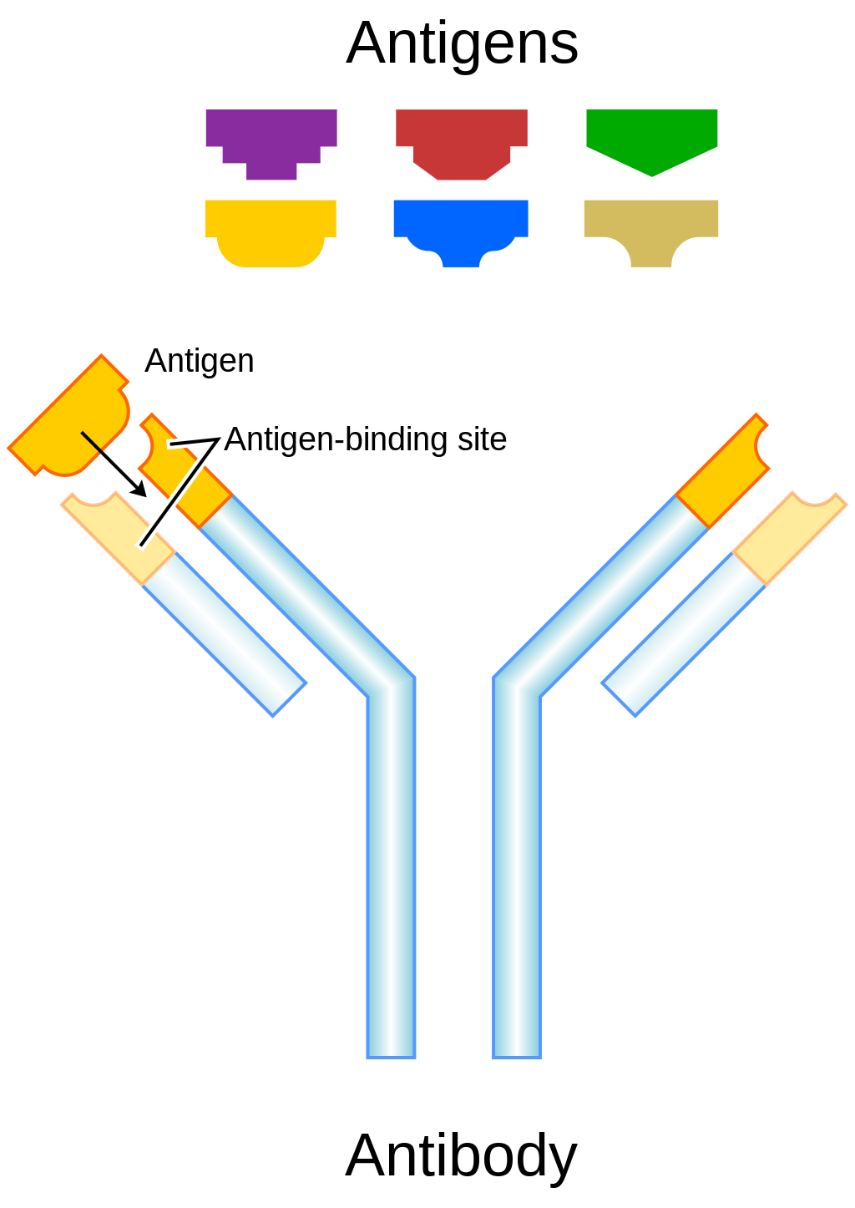
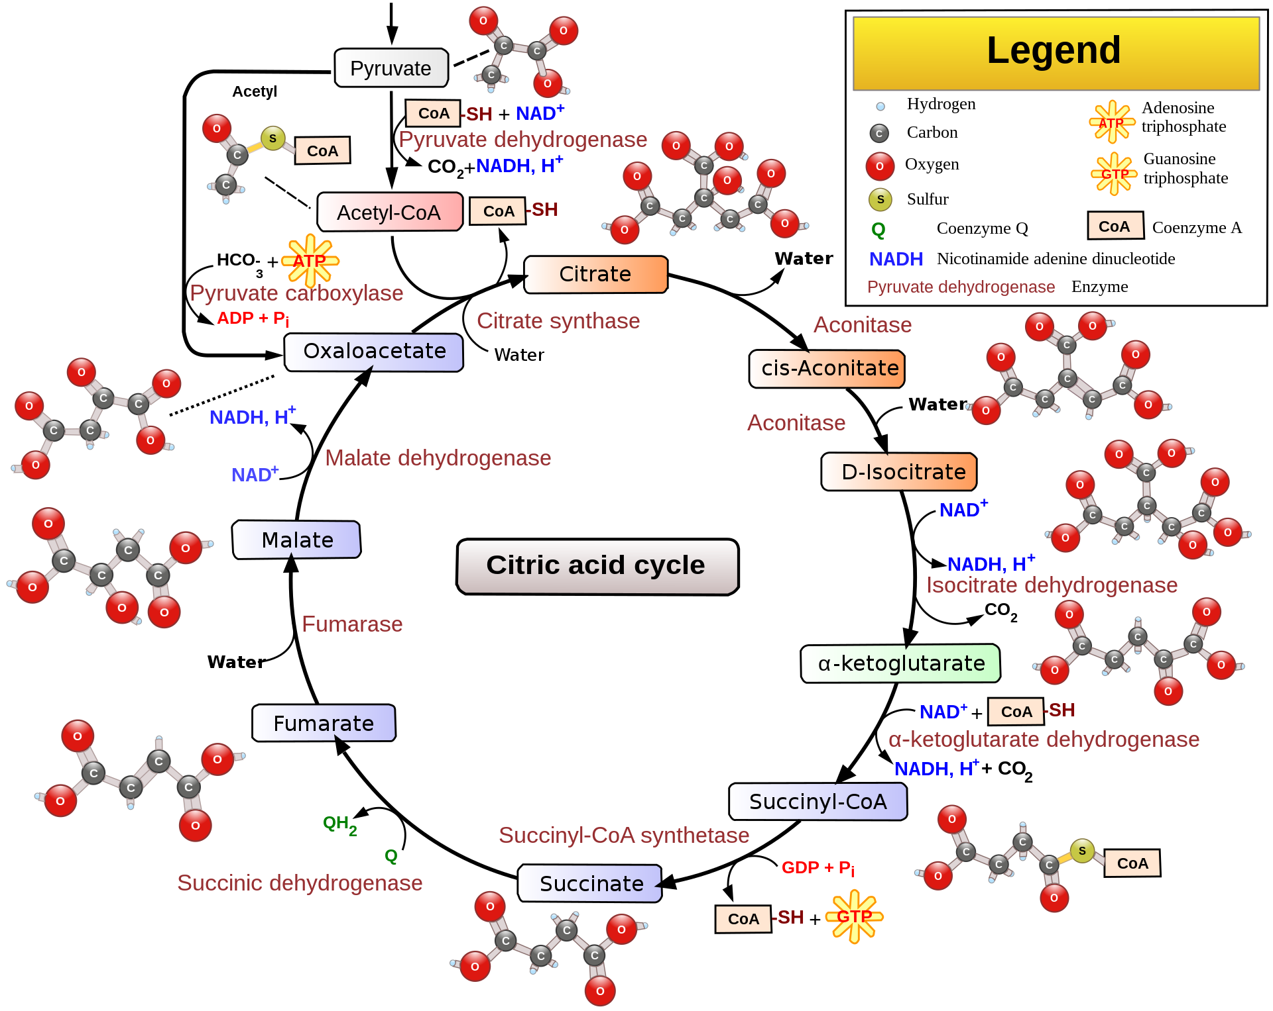
Models
Models are simplifications of the world that include information needed to understand a specific aspect of a system without other detail.
Science is about model building and testing.
Models should be as complicated as needed to explain a phenomenon, but no more.

Slide 10
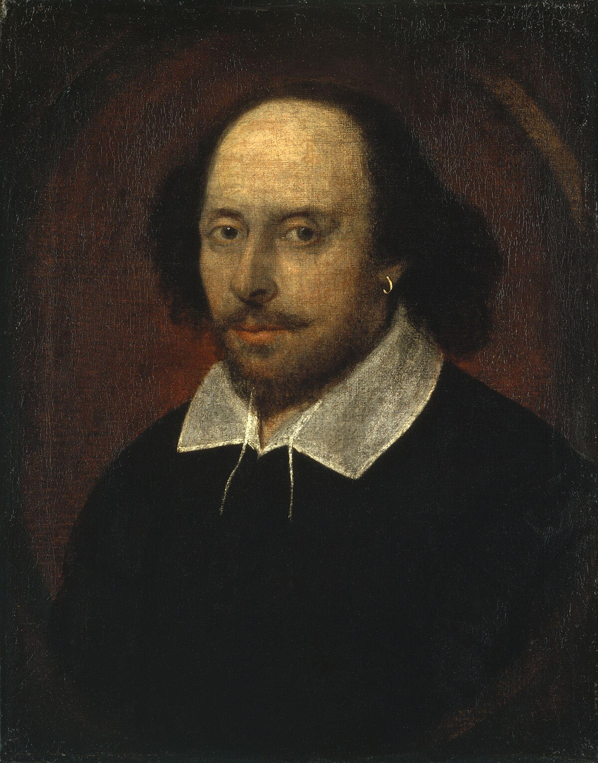
Models
Shakespeare on statistical modeling (according to Chat-GPT-4, which is itself a model)
Ah, fair statistics! Thou art the lens through which the world is seen, the key that doth unlock the vaults of truth. In science's realm, where shadows oft do dance and mysteries abound, thy numbers are the stars that guide our quest. With thee, we sift the chaos of the natural world, and from its tangled threads, weave patterns of meaning and law.
Through thee, we measure the pulse of nature's heart, discern the rhythm in the rise and fall of life’s tide, and find in the smallest mote the echoes of the grand design. For what is science but the pursuit of truth? And what is truth, if not the clarity that thy figures bring?
But let us not forget, sweet statistics, thy power is double-edged. For in careless hands, thou art but a trickster, a jester donning the garb of reason, leading us astray with false conclusions and misguided whims. Yet, in the hands of the wise, thou art a beacon, a torch that lights the path to knowledge, and in thy glow, the darkness of ignorance doth fade away.
So let us cherish thee, fair statistics, as the scientist’s most trusted friend. For in thy embrace, we grasp the very essence of the world, and in that grasp, we hold the power to shape our destiny.

Slide 11
Statistical Models
Good statistical modeling accomplishes two goals
1. It includes a quantitative description of a biological process
2. It quantifies uncertainty that arises from sampling of a population
Scientists are interested in populations (all individuals for which the question applies), but can only collect data on a sample

Slide 12
An Example in Action
Highly Pathogenic Avian Influenza (HPAI) recently spilled into cattle
USDA reports farms that have the infection by date
Question: Is anything currently limiting the rate of infections across farms?
Data: collected infections by date from USDA
Model: Unlimited population growth indicated by exponential growth.
(Note: deterministic exponential growth shows a straight-line relationship between log(individuals) and time)

Slide 13
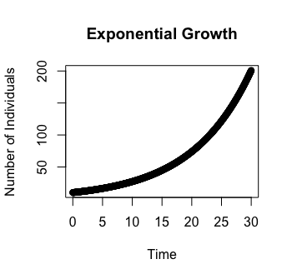
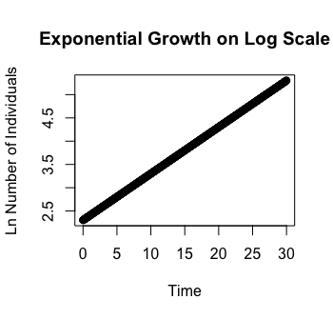
Exponential Growth

Slide 14
An Example in Action
Highly Pathogenic Avian Influenza (HPAI) recently spilled into cattle
USDA reports farms that have the infection by date
Question: Is anything currently limiting the rate of infections across farms?
Data: collected infections by date from USDA
Model: Unlimited population growth indicated by exponential growth.
(Note: deterministic exponential growth shows a straight-line relationship between log(individuals) and time)
Fit Parameters:
Parameter of interest is the slope. The slope is the growth rate over the time period.
Slope estimated to be r = 0.0146, p < 10⁻¹⁶

Slide 15
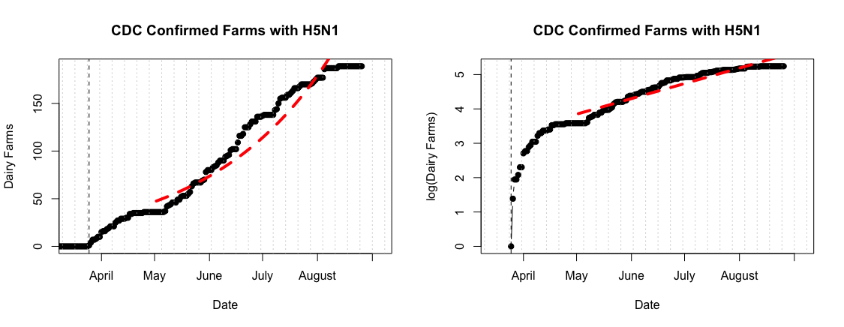
An Example in Action
I’ve got a significant result, I’m good right?
NO, need to evaluate whether the model does a good job describing the data.
Model is lacking for fit with data
Conclusion: not exponential growth. Something is limiting spread of H5N1 on farms

